Slide 1
WeFeet
Tom Baeten – Kevin van Driel
Atte Paananen – Robin Huumonen
Quinten Schutyser – Lennert Van Riel

Slide 2
Individual contributions for international project

Slide 3
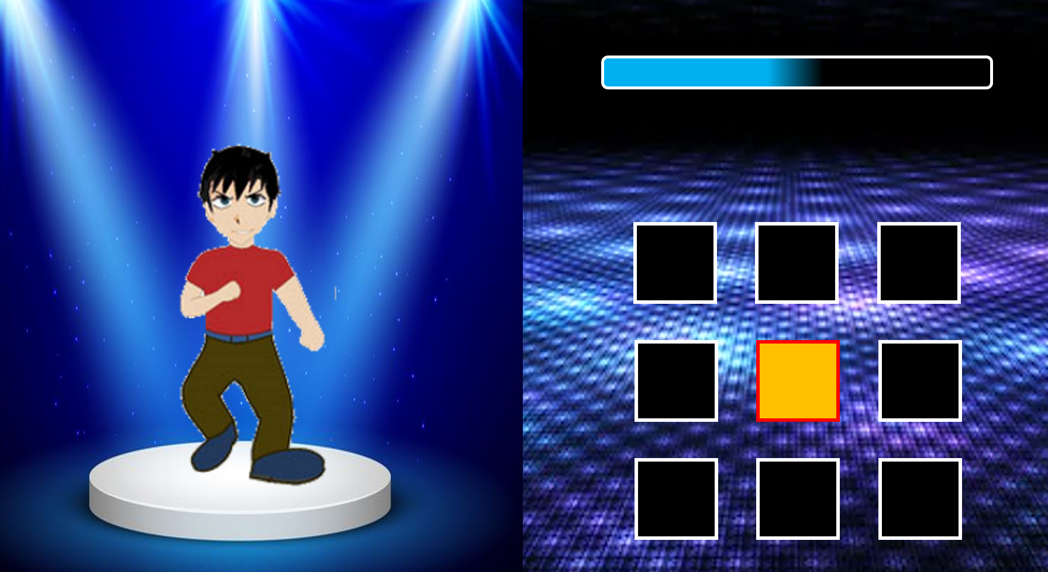
Tom Baeten
Menu
Created dance movies
made with powerpoint ☺
Incl Timings
Helping button controls
Simulate mat code for arduino
Notes:
Tom

Slide 4
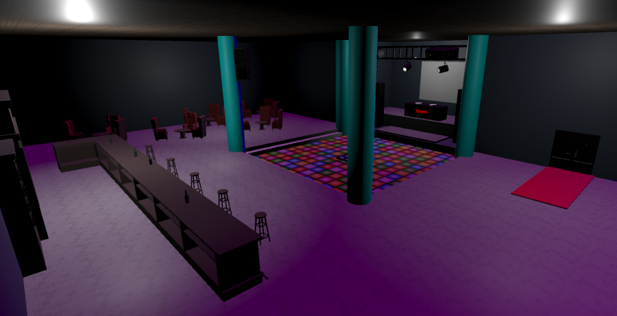
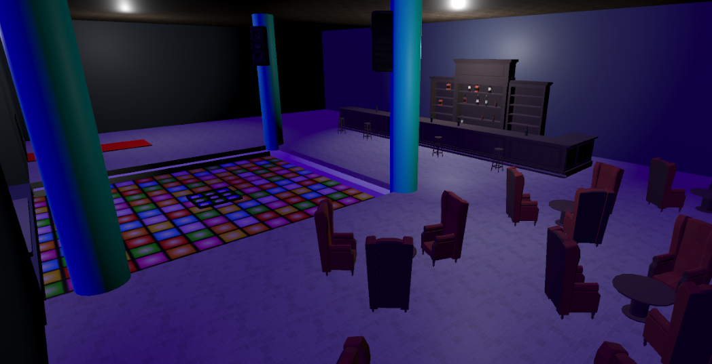
Kevin van Driel
Disco scene
Player via steam vr
Testing code, giving feedback
Testing mat via dummy arduino buttons
Testing and connecting the real mat
Record demo's
Notes:
Kevin

Slide 5
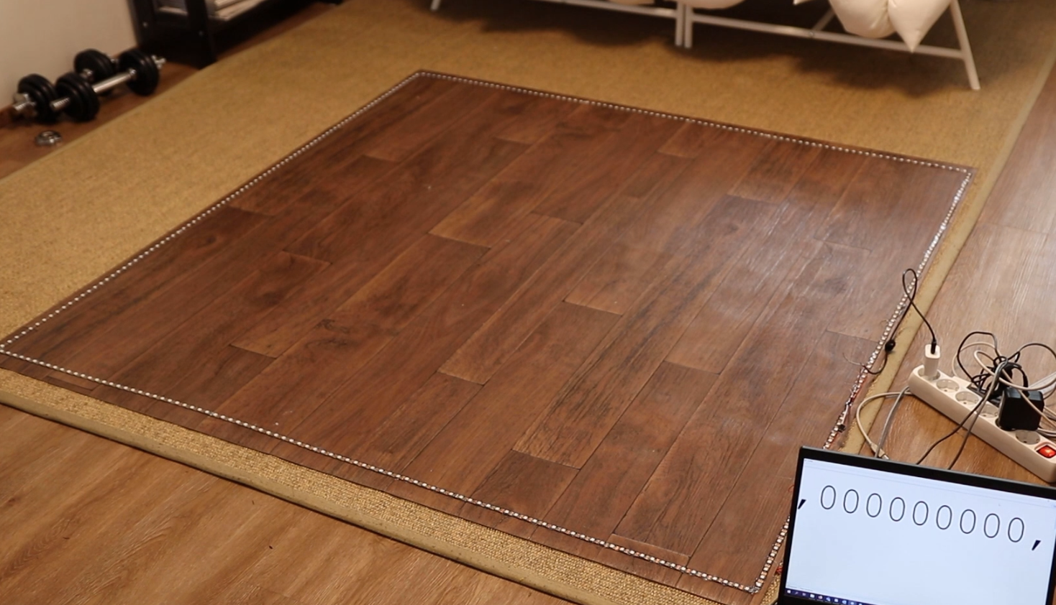
Atte Paananen
Testing different ways to build the mat
Assembling the mat
Finalizing the Arduino code to work with the mat
Notes:
Atte

Slide 6
Robin Huumonen
Technology tests and selection
Arduino code for the mat and LEDs
Notes:
Robin

Slide 7

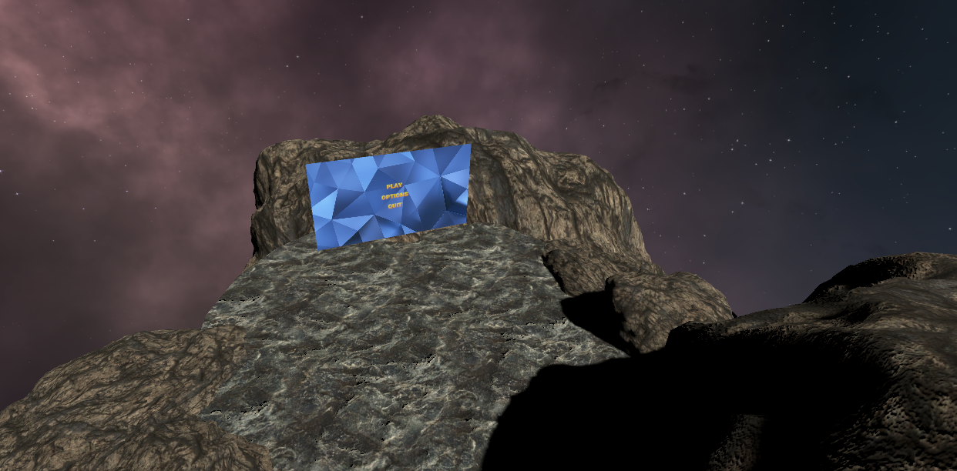
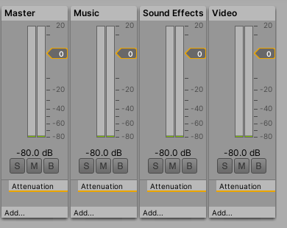
Quinten Schutyser
Menu scene
Sound (Audio Manager)
Button control
Helping with Menu
Option Menu
Notes:
Quinten

Slide 8
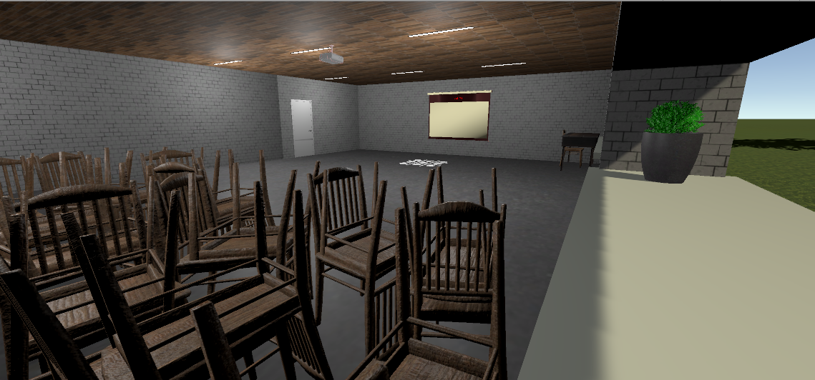
Lennert Van Riel
Cinema/classroom scene
Serial communication in Unity
Move detection and visualization
Scripts for the dances
Scoring script
Notes:
Lennert

Slide 9
Individual contributions for 3D Game Development

Slide 10
Tom Baeten
Script for recording custom song
Using VR controller to add moves in a list
Using previous class to read moves from mat
Using VR controller to stop recording
Write CSV with moves and timings
Help to fix problems
Notes:
Tom

Slide 11
Kevin van Driel
Setting up the mat
Find songs
Copy music from C:/users/music to project
Make list with songs we can make
Make list with songs that are already made
Linking scripts
Help testing and debuging
Notes:
Kevin

Slide 12
Quinten Schutyser
Making a GameManager
For a connection between different scene’s
Adding extra functions to the sound manager
For changing the music with imported music-files
Adding extra menu’s
For choosing if you wane make a song or create a song
Making list scripts
For show a flexible list where you see all the song and dances your created
Helping with fixing problems
Notes:
Quinten

Slide 13
Lennert Van Riel
Script for playing a custom song
Reading from csv
Checking for correct moves with mat input
Showing progress bar
Showing score
Showing move on screen
Notes:
Lennert

Slide 14


Teamwork
What went well
Communication
Setting up
Learning Unity
Creating mat
Notes:
Lennert

Slide 15

Teamwork
What went wrong?
Corona ☹
Keeping the Jira up to date
Not getting distracted with extra features
What would we change?
More clear userstories
More communication between sprints
Better unity structure in imports
Notes:
Quinten

